Slide 1
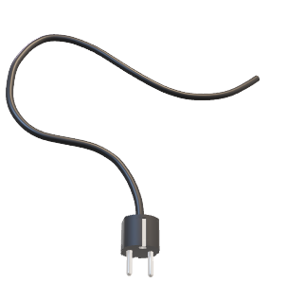

Developments in Modern Battery Design and Charging
EECE 592-01
Dr. Mauro
By: Dean Riccio

Slide 2
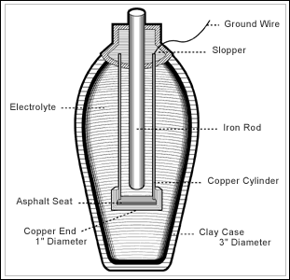
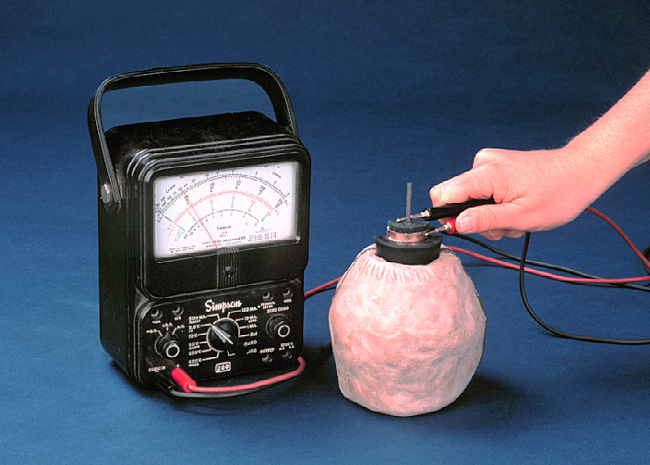
History Of The Electric Battery
The first electric battery was developed and improved upon during the 19th century, but the first battery was believed to be invented during the Parthian period between 250 BCE and 250 CE.
Battery was designed using a clay filled jar and an iron rod was surround by a copper cylinder.

Slide 3
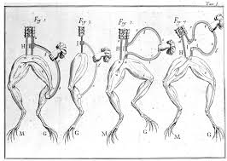
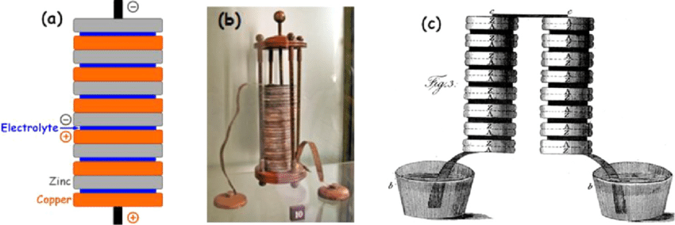
History Continued
In 1791 Luigi Galvani was an Italian scientists who discovered frog legs would contract when forming a circuit with two different types of metal. Galvani then created the term “animal electricity” as a result of the experiment.
Alessandro Volta disagreed and thought that Galvani's experiment was a result of the two different types of metals working with the frog legs between them.

Slide 4
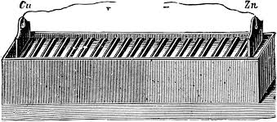
Improvements To Volta’s Original Vision
William Cruickshank had the first electric battery created for mass production by 1802. Cruickshank used zinc and copper plates and filled the wooden box with an electrolytic solution.
The copper was the positive terminal of the battery, while the zinc was the negative terminal.

Slide 5
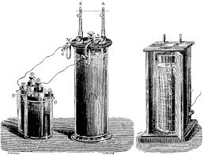
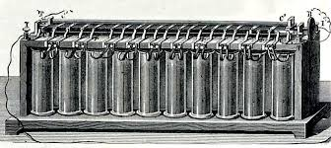
The First Rechargeable Battery
Designed by Gaston Planté in 1859 using a lead acid system. Planté discovered that a lead acid battery could be charged by passing reverse current with the battery containing lead anodes and dioxide cathodes.
Developments upon rechargeable batteries continued, with the nickel-cadmium battery being created in 1899 by Waldmar Junger.

Slide 6
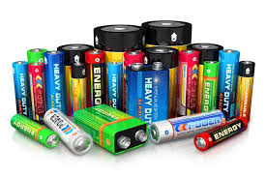
Types Of Batteries
With todays technology and electronics, there are many different battery types that can be used depending on the application.
These include lithium ion, lead acid, nickel metal hydride, alkaline, and lithium polymer.

Slide 7
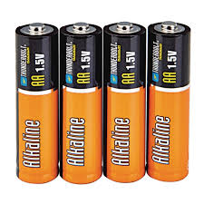
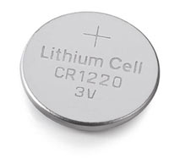
Applications Of Each Battery Type – Non-Rechargeable
Alkaline Batteries:
Watches
Remotes
Wall Clocks
Handheld Gaming Consoles
Coin Cell Batteries:
Miniature Electronics (toys)
Wall Clocks
Watches

Slide 8
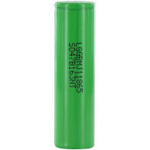
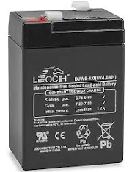
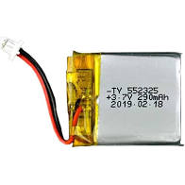
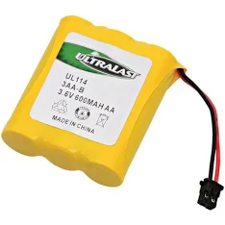
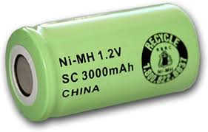
Applications Of Each Battery Type - Rechargeable
Nickel Cadmium / Nickel Metal Hydride
Lead Acid
Lithium-Ion
Lithium Polymer
RC Toys
Cordless Phones
Solar Lights
Portable Devices
Cars
UPS (uninterrupted Power Supply)
Robotics
Heavy Machinery
Drones
Robotics
RC Toys
Portable Phone Chargers
Phones
Bluetooth Headsets
Laptops
Drones
RC Toys

Slide 9
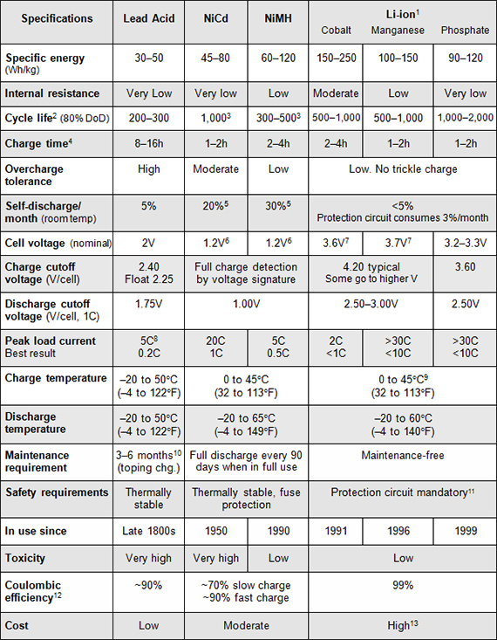

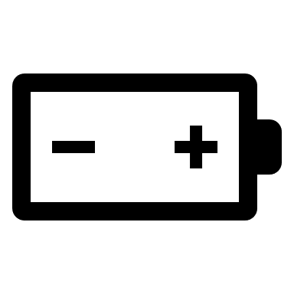
Specifications Of Lead Acid, Ni-Cad, Ni-MH, Li-ion

Slide 10
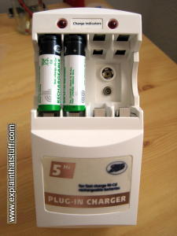
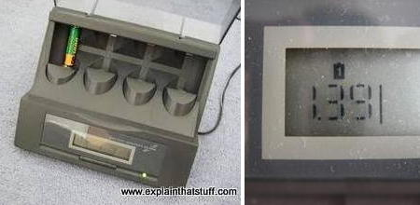
Charging Methods
Depending on the battery type selected and ratings will ultimately determine what charger is needed to properly charge the battery.
A general rule of thumb is to never mix and match different chargers for different types of batteries.

Slide 11
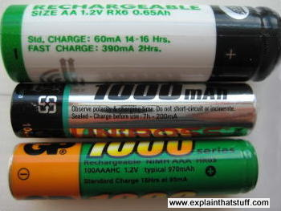
Charging Methods Continued
Many rechargeable batteries include labels with steady charge and fast charge ratings.
Batteries are also often labeled with the milliamp hours they contain.

Slide 12
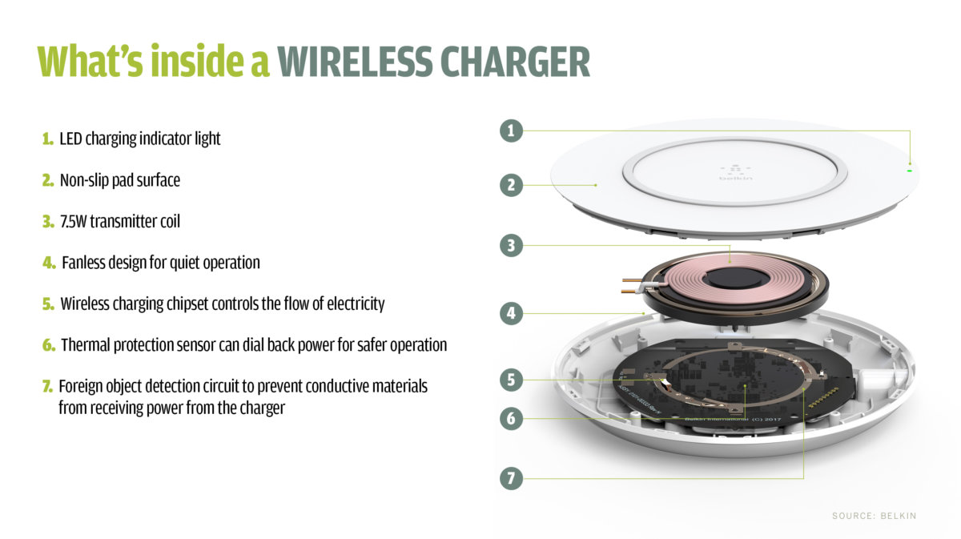
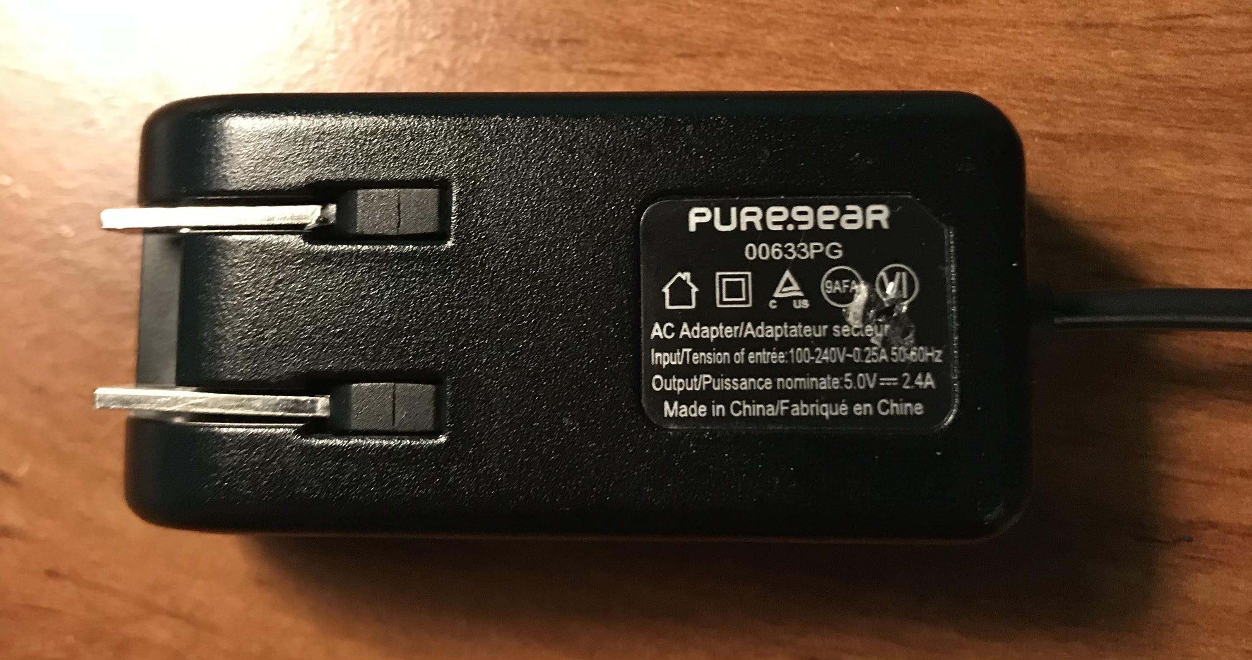
Developments In Modern Battery Design And Charging
Fast charging and wireless charging are two examples of recent technology that has improved the way consumers can charge their batteries.
Wireless charging, while still a relatively new concept has made a lot of progress in the last couple of years.

Slide 13
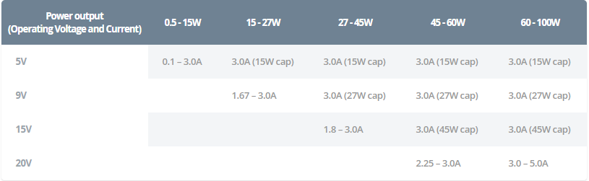
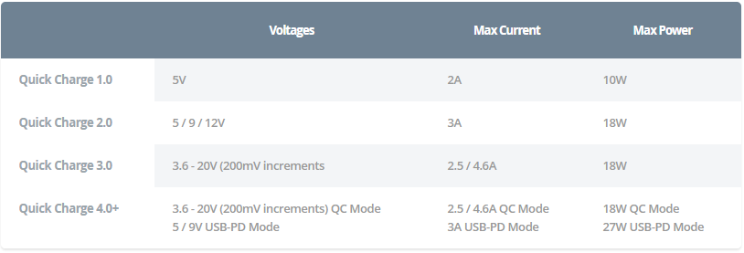
Fast Charging With USB Power Delivery

Slide 14
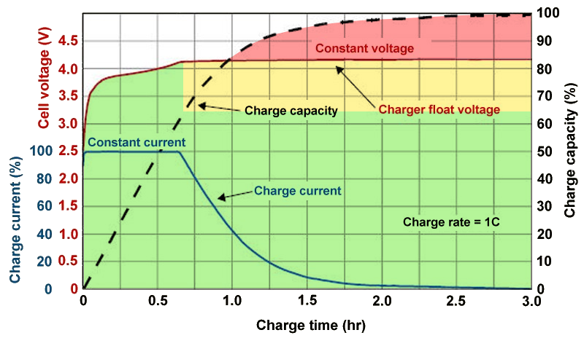
Fast Charging A Lithium-Ion Battery
Charging a Lithium-Ion battery is generally split into two phases: the constant current and the constant voltage phase.
A lithium-ion battery has a nominal peak voltage of around 4.2V.

Slide 15
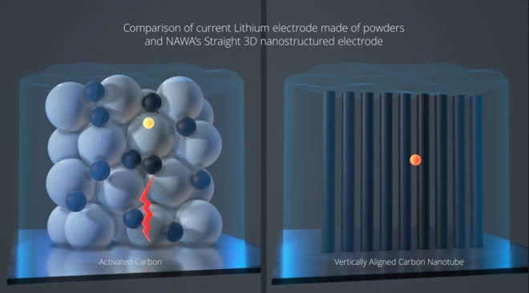
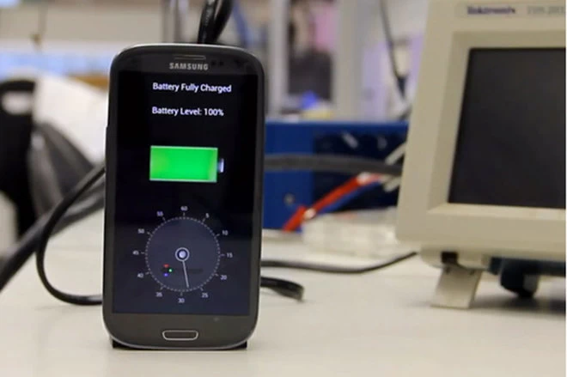
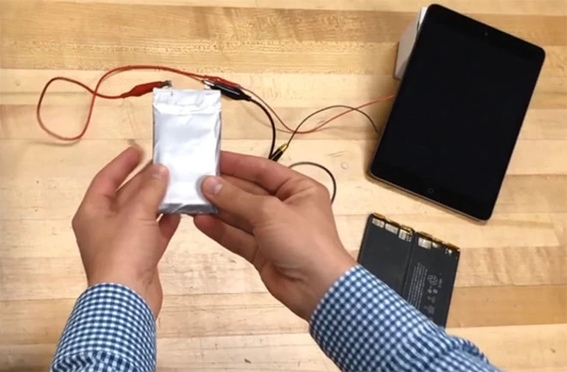
New Battery Designs/Chargers In Development
StoreDot is creating a battery charger that can charge the battery of a cell phone in 60 seconds.
Mike Zimmerman at Tuffs University is developing a safer alternative to lithium-ion batteries.
Vertically aligned carbon nanotube electrodes, allows a reduction in carbon emissions.

Slide 16
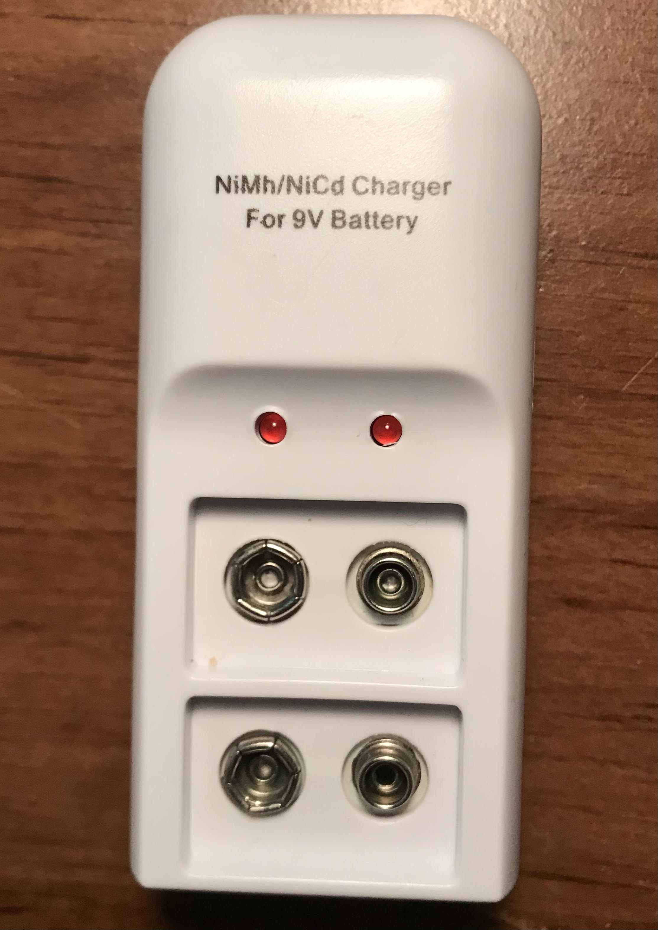
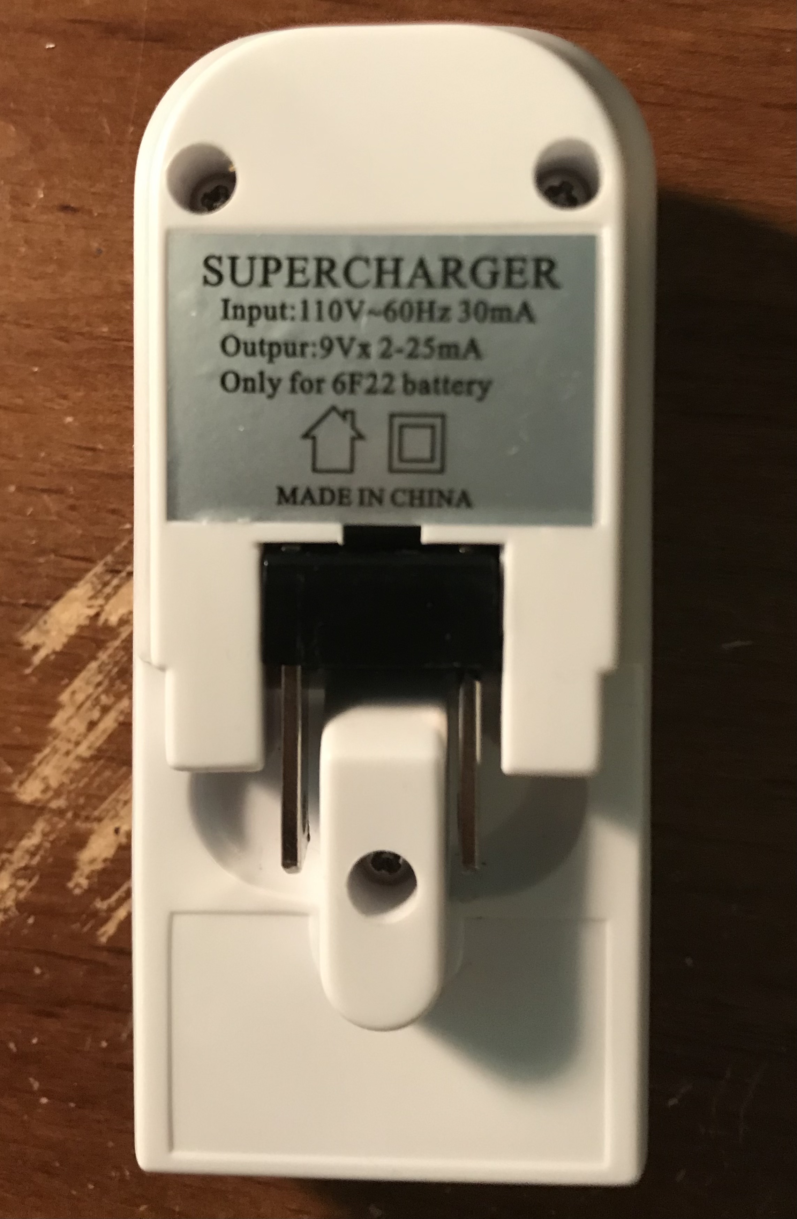
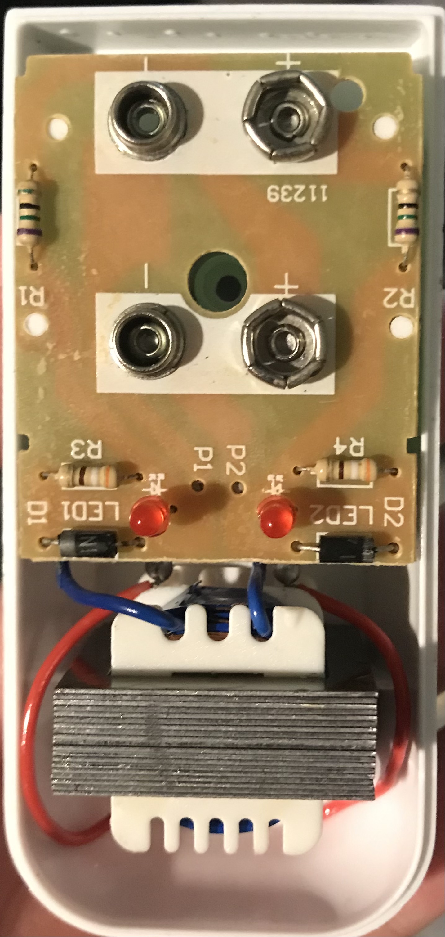
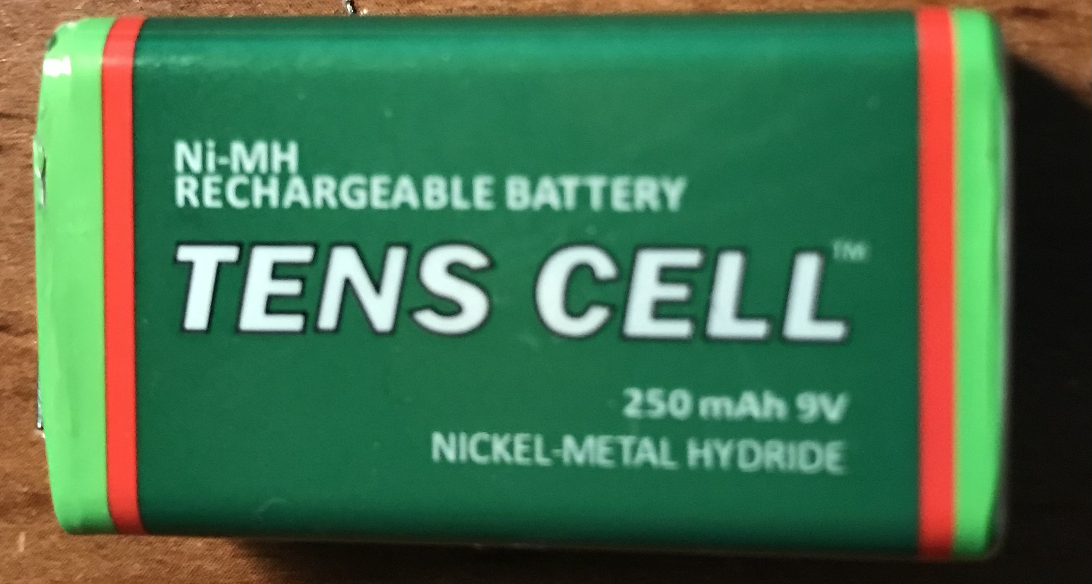
Nickel Metal Hydride/Nickel Cadmium Charger Demonstration
Nickel Metal Hydride 9V Rechargeable Battery
Ni-MH/Ni-Cd Charger
Internal Components

Slide 17
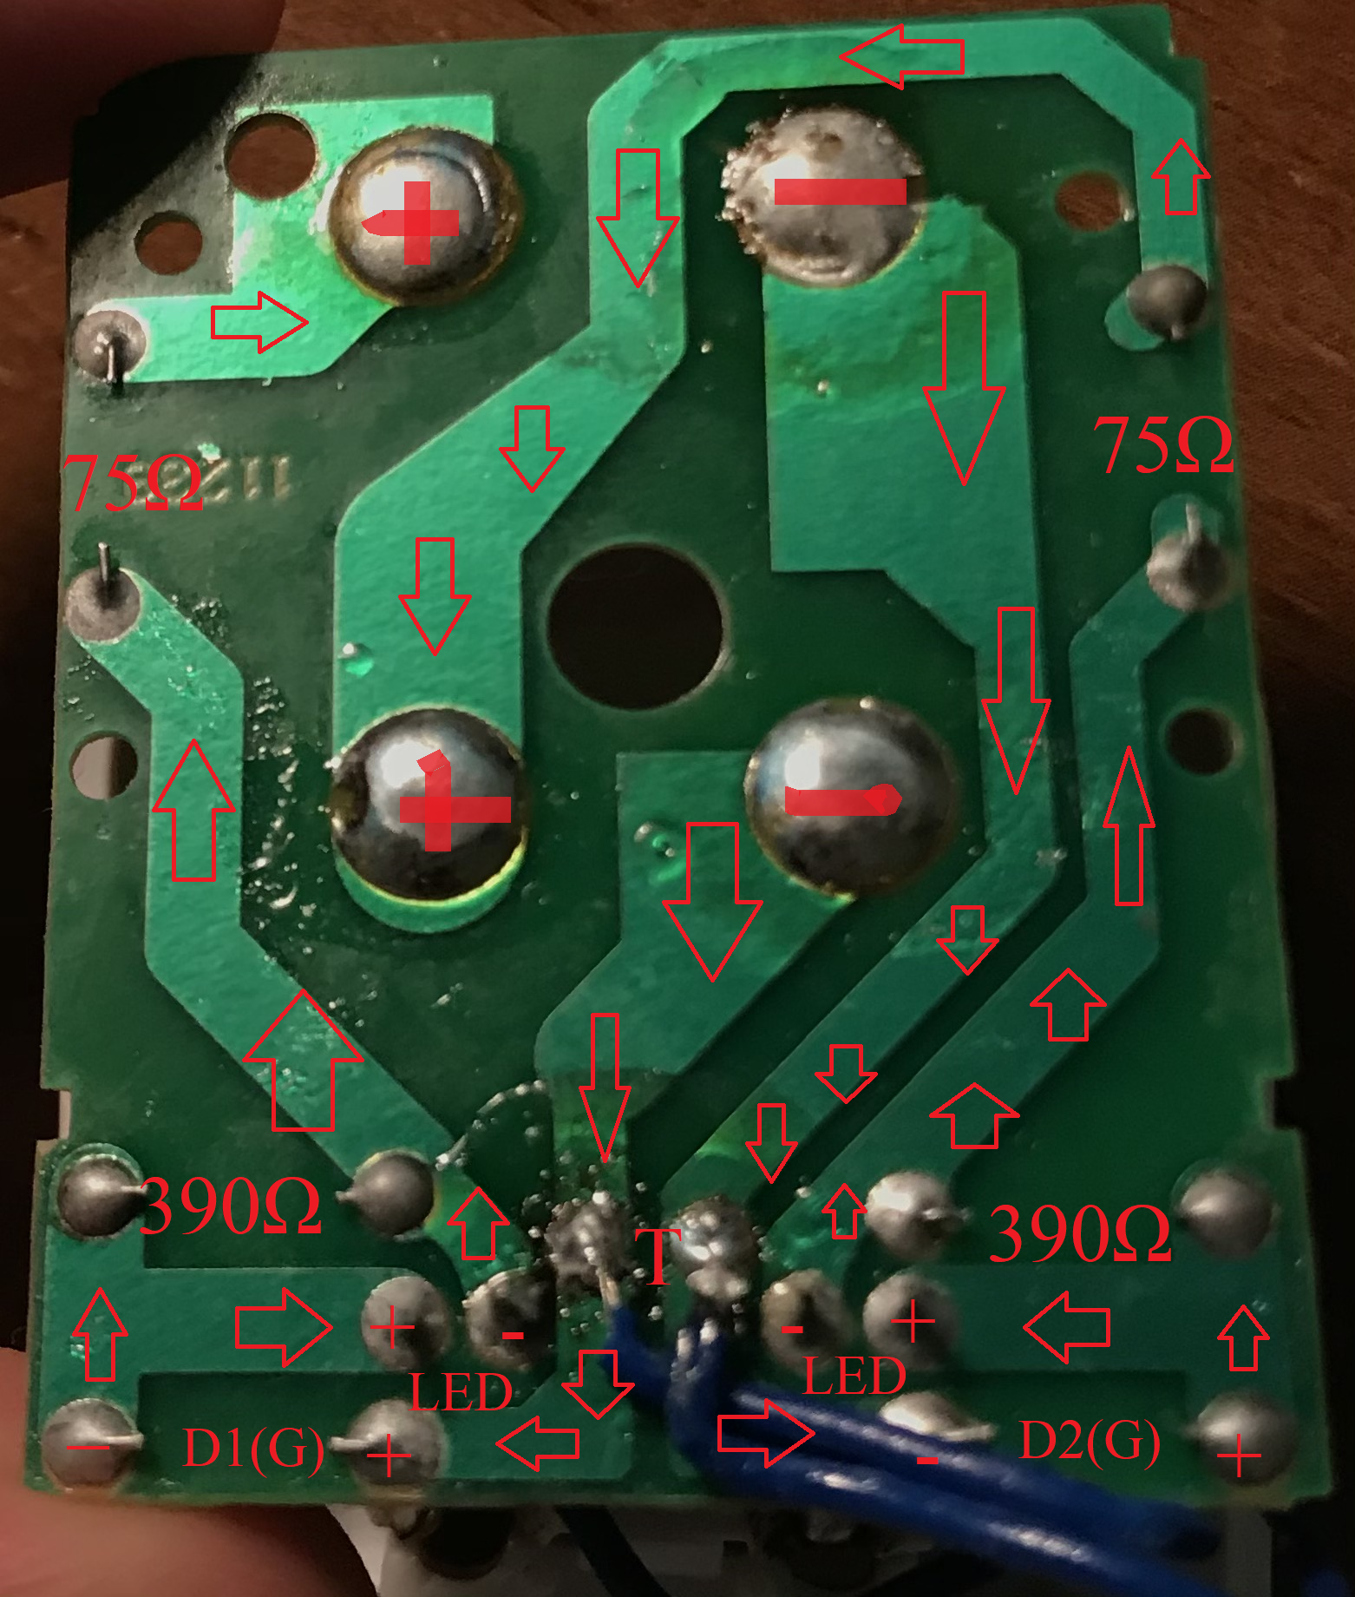
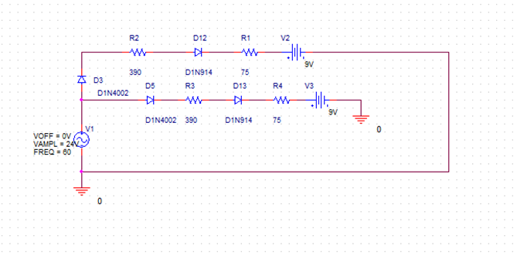
Determining the layout of the circuit

Slide 18
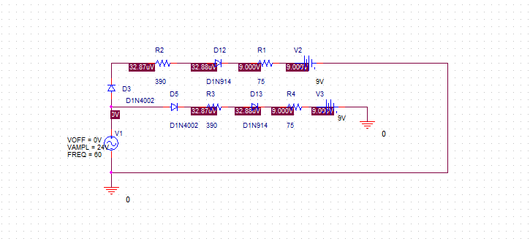
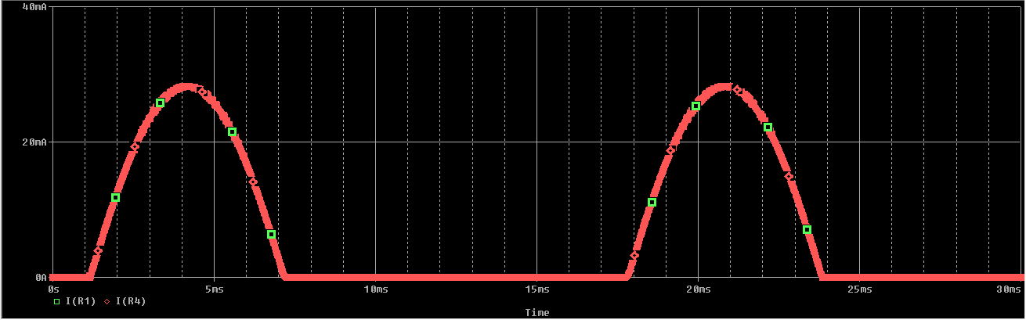
Negative Clipper Circuit With Bias Voltage - Results
Pspice Schematic
Output Current at R1/R4

Slide 19
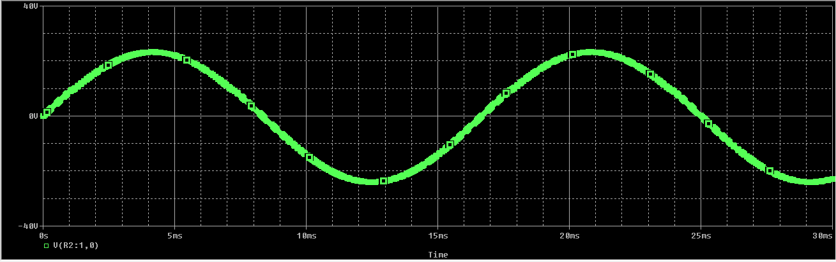
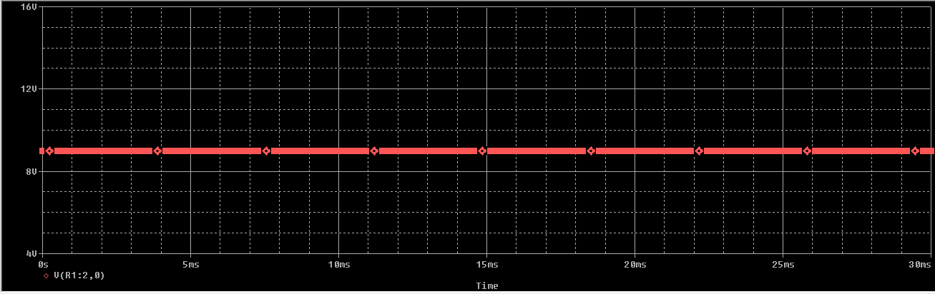
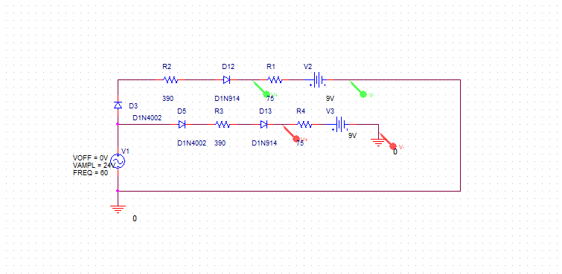
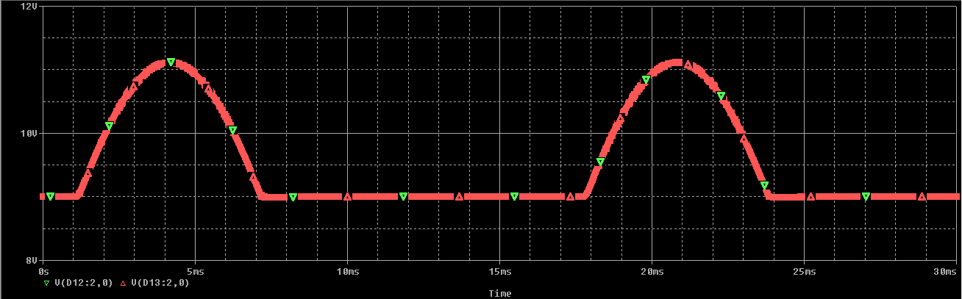
Input And Output Of Clipper Circuit
Vin
9V Battery Output (DC)
Measuring Vout
Vout

Slide 20
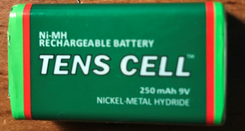
Calculating The Charge Rating Of The Battery
Depending on the manufacturer and company producing the battery may give different results in terms of charge time.
Charge Time = Battery mAh capacity / mA charge rate
For my battery, the rating would be:
Charge Time = 250mAh/25mA = 10 hours

Slide 21
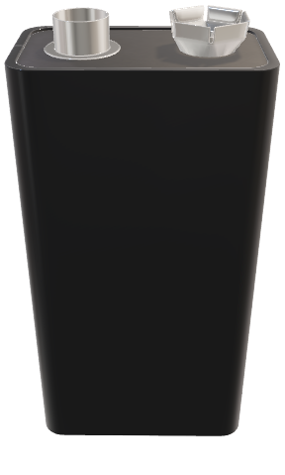
Summary
Despite batteries existing for thousands of years, the fundamental design of a battery has ultimately unchanged.
Todays generation offers many different battery types, including wireless, li-po, alkaline, rechargeable, non rechargeable.

Slide 22
References
https://www.pocket-lint.com/gadgets/news/130380-future-batteries-coming-soon-charge-in-seconds-last-months-and-power-over-the-air
https://circuitdigest.com/tutorial/diode-clipper-circuitsG
https://www.androidauthority.com/fast-charging-explained-889780/G
https://components101.com/articles/different-types-of-batteries-and-their-uses
https://www.computerworld.com/article/3235176/wireless-charging-explained-what-is-it-and-how-does-it-work.html
https://www.digitaltrends.com/mobile/how-does-fast-charging-work/
https://libraries.mit.edu/collections/vail-collection/topics/electricity/the-voltaic-pile/
https://news.stanford.edu/2020/06/22/new-electrolyte-design-may-lead-better-batteries-electric-vehicles/
https://batteryuniversity.com/learn/article/when_was_the_battery_invented#:~:text=Invention%20of%20the%20Rechargeable%20Battery&text=In%201859%2C%20the%20French%20physician,that%20is%20still%20used%20today.
https://www.explainthatstuff.com/how-battery-chargers-work.html#:~:text=NiMH%20batteries%20can%20be%20fast,rapid%20nicad%20charger%20may%20overcharge

Slide 23
Questions?

